Slide 1
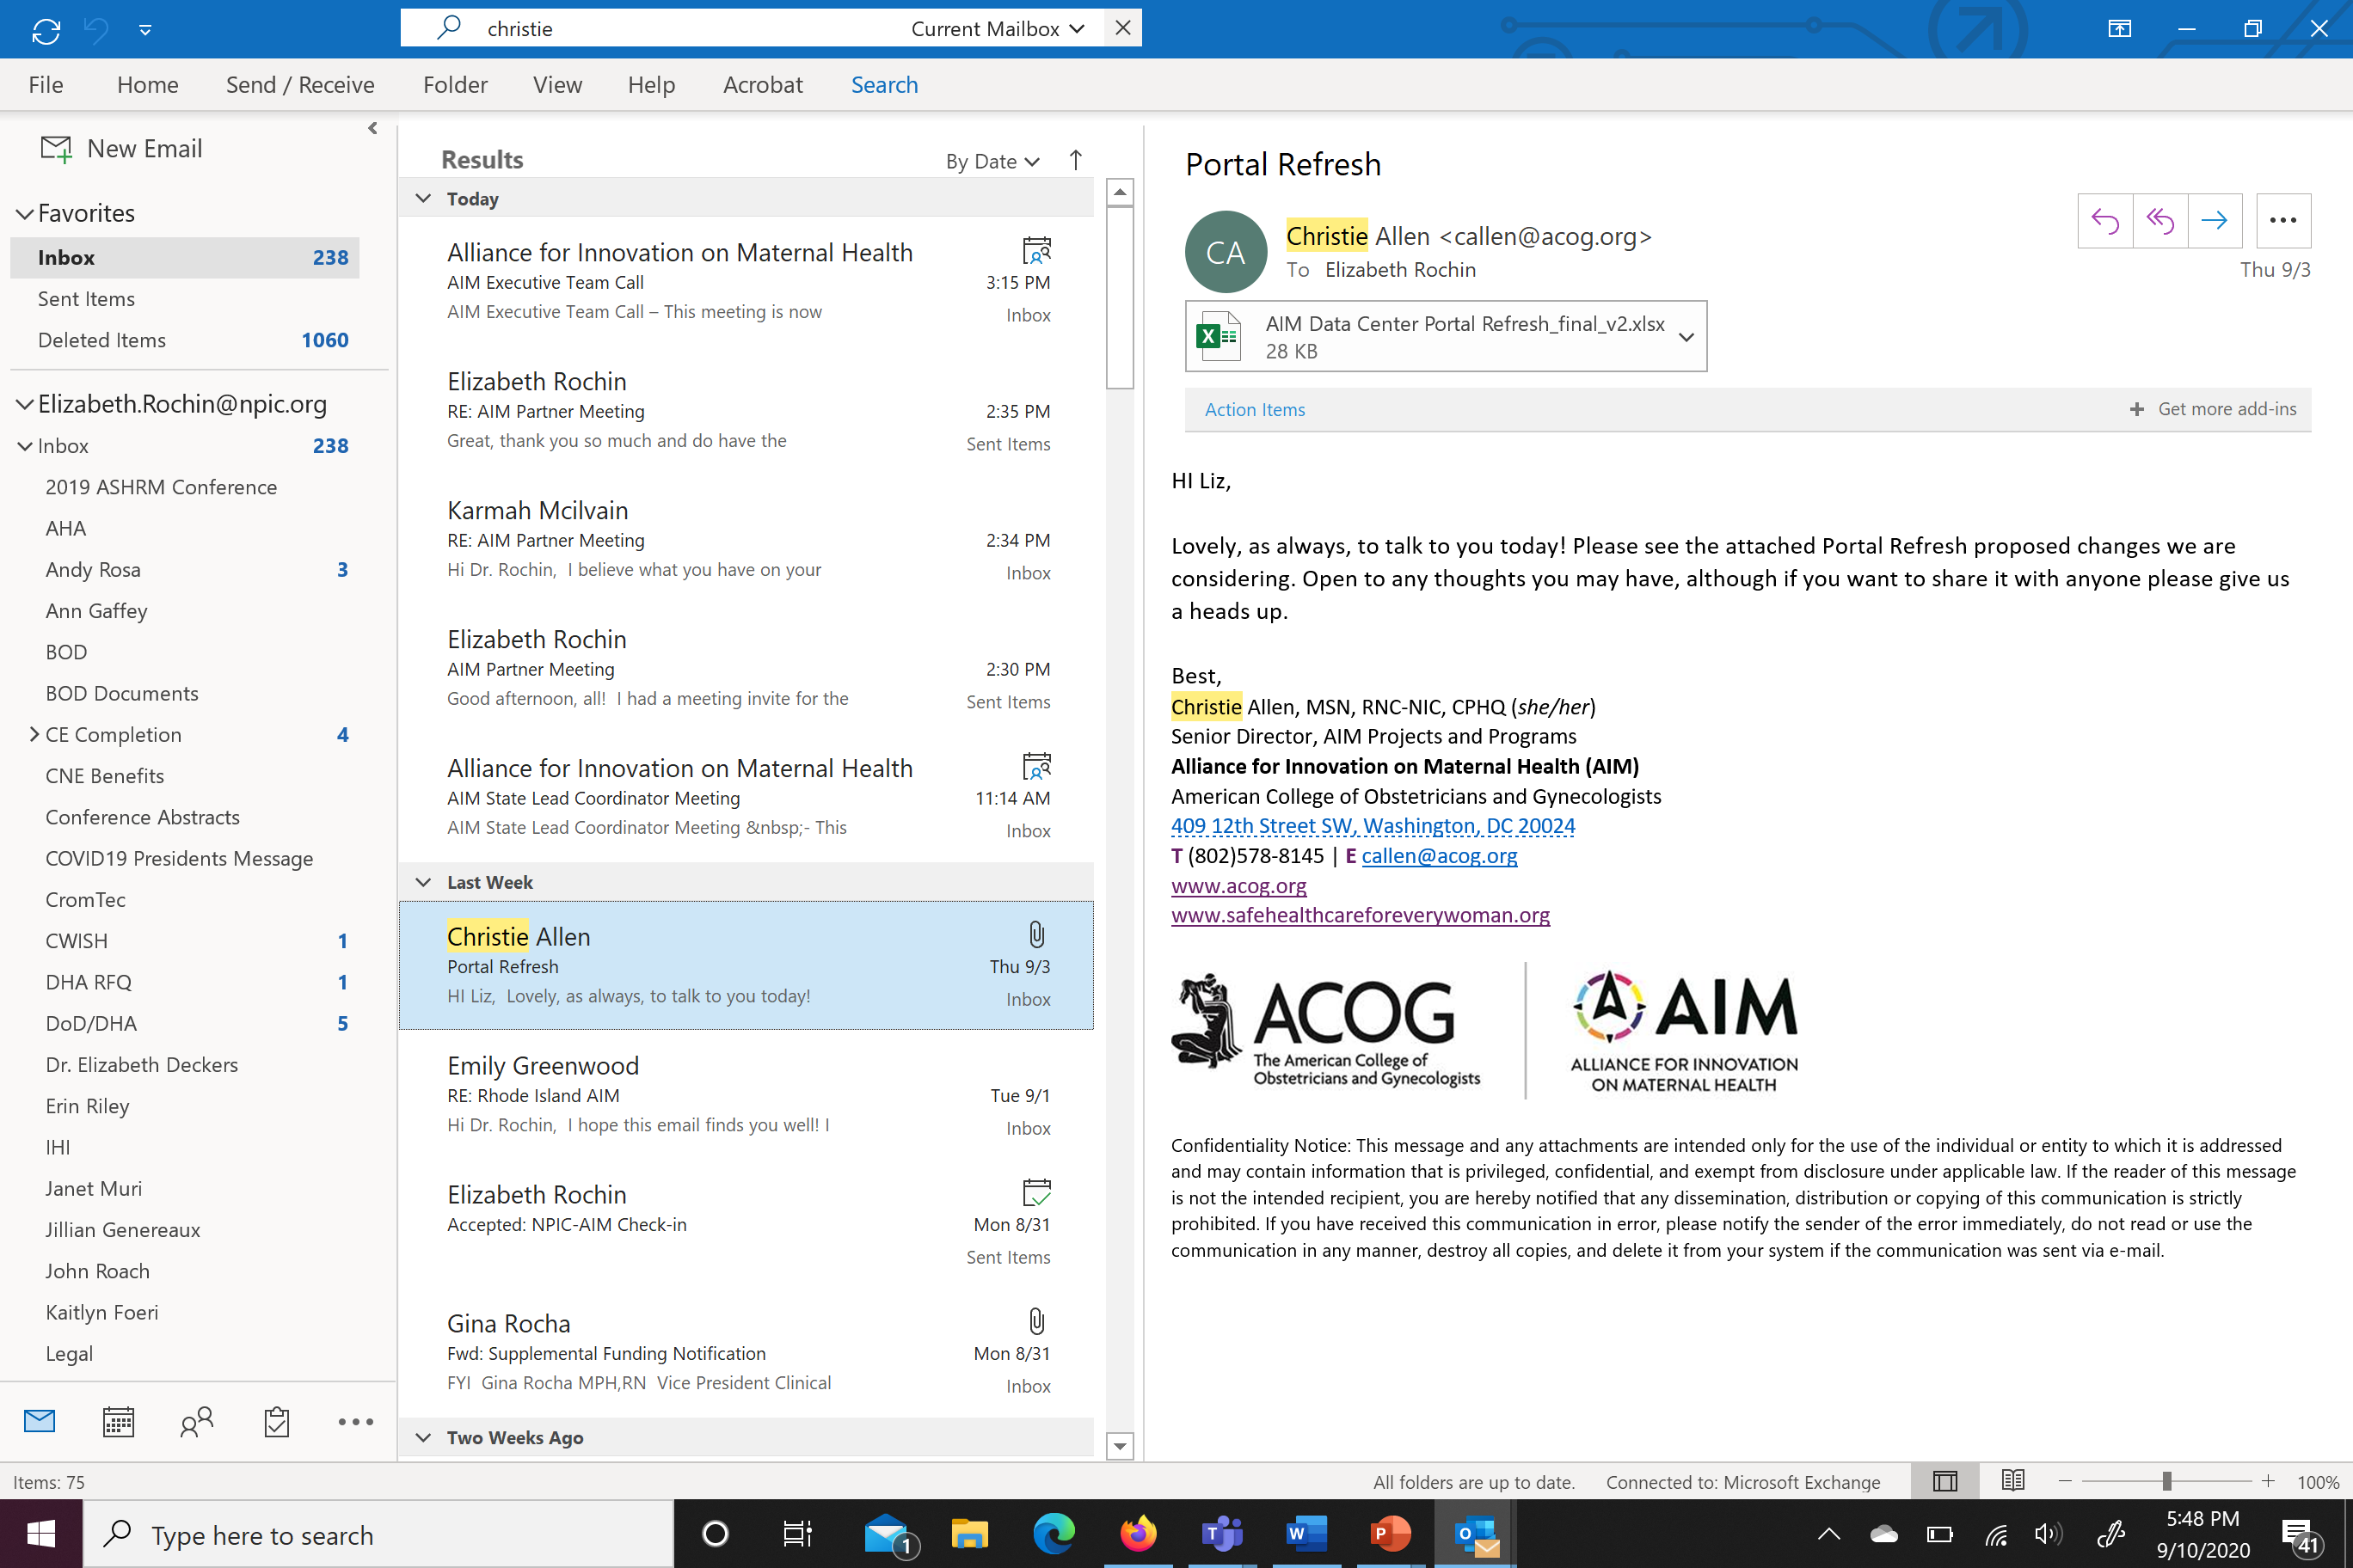
Welcome to Rhode Island AIM
Charting the Way Ahead:
Reduction of Postpartum Hemorrhage in
Rhode Island
May 24, 2022

Slide 2
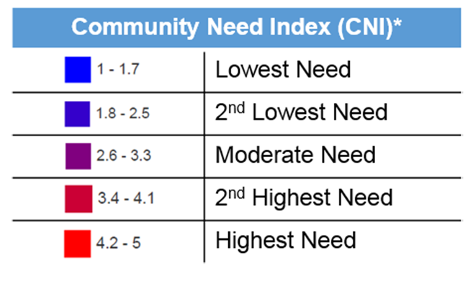
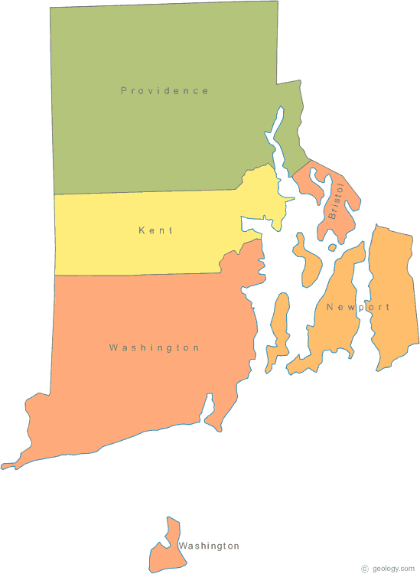
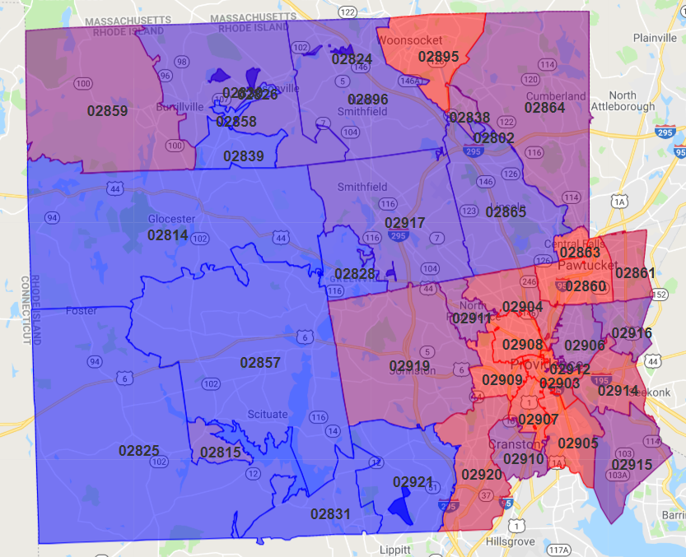
Rhode Island Snapshot
Slightly > 1 Million Lives
71.3 % White
6 % African American
3.6% Asian
.7 % Indigenous Nation
16. 6 % Latino
1 of every 4 speaks other languages
The CNI is based on 5 socioeconomic barriers: Income, Culture/Language, Education, Insurance, Housing Status.

Slide 3

Rhode Island : Hospitals & Health Systems
15 Hospitals
3 Health systems; 5 Birthing Hospitals
4 - Hospital system includes the only level 3 Trauma Center ( 1000 Beds), Comprehensive Pediatric Facility
3 - Hospital system includes largest Birthing Facility and RI’s only level IV NICU; the only adult Psychiatric (150 Beds)
1 For-Profit system (2 hospitals)
One Independent ( 100 Beds)
One Rehab facility
One Long Term Care

Slide 4
Why Rhode Island Joined AIM
Preventing maternal morbidity and mortality a priority
RI passed legislation to establish the Maternal Mortality Review Committee in 2019
RI launched AIM Collaborative in August 2020 with an initial focus to eliminate racial and ethnic birthing disparities
RI becomes the 33rd state to join AIM with a focus on the Post Partum Hemorrhage Bundle
AIM Severe Maternal Morbidity (SMM) among Hemorrhage Cases at or slightly above NPIC benchmark

Slide 5
Rhode Island State Team
2019 MMRC*
2020 AIM Launch
2021 -2022 PNQCRI
2021 PPDRC Initial Report
PNQCRI
NPIC
DOH
PPDRC*
HARI

Slide 6
RI AIM Workplan
Overarching goal:
By September 2021 Rhode Island’s participating hospitals will individually reduce the rate of severe maternal morbidity among hemorrhage cases by 20%.
All maternity units in participating RI AIM hospitals:
1) Demonstrate increased readiness, recognition and prevention of obstetric hemorrhage
2) Prepare and have established standardized plans to respond to obstetric hemorrhage
3) Accelerate self-documented race and ethnicity data to better define disparities within obstetric hemorrhage

Slide 7
RI Deliveries: 3 Year Trend
Source: Hospital Discharge Data

Slide 8

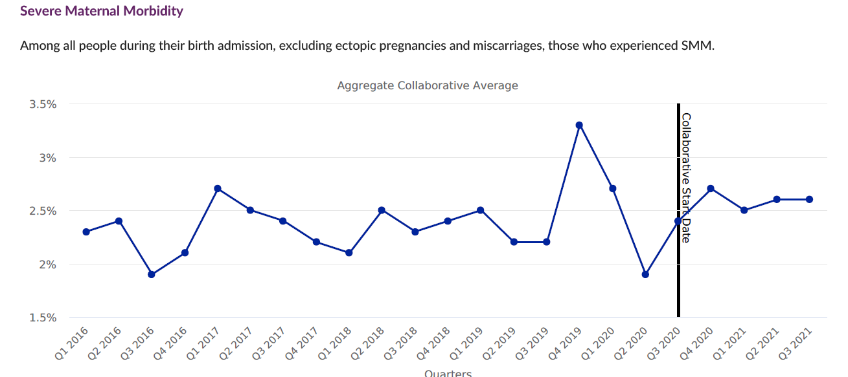
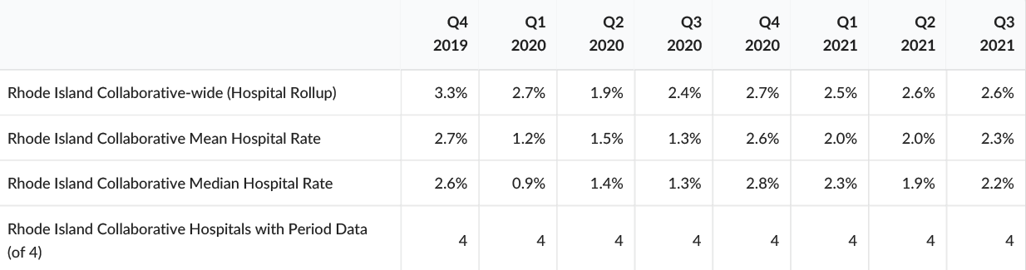
Severe Maternal Morbidity

Slide 9
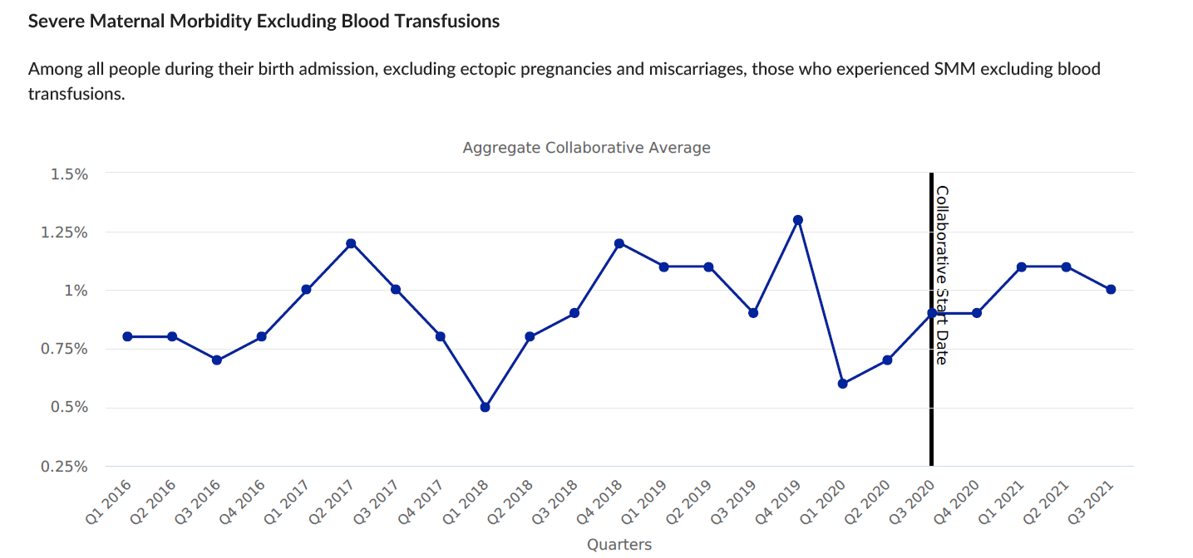
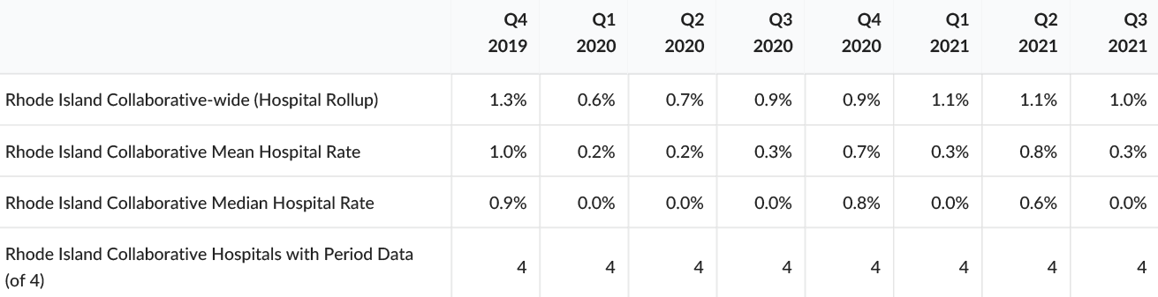
Severe Maternal Morbidity excluding Blood Transfusions

Slide 10
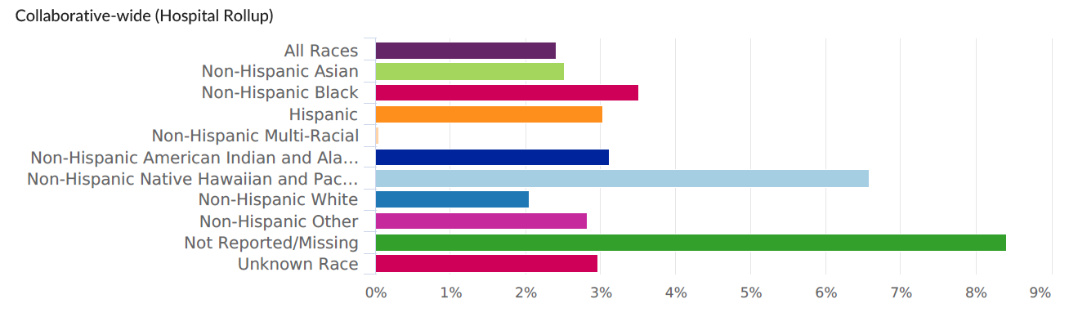
Severe Maternal Morbidity (Q1 2016 - Q3 2021)
Race | Collaborative-wide (Hospital Rollup) Rate | Collaborative-wide (Hospital Rollup) Numerator | Collaborative-wide (Hospital Rollup) Denominator
All Races | 2.41% | 1402 | 58177
Non-Hispanic Asian | 2.51% | 19 | 756
Non-Hispanic Black | 3.50% | 166 | 4737
Hispanic | 3.02% | 156 | 5163
Non-Hispanic Multi-Racial | 0.00% | 0 | 19
Non-Hispanic American Indian and Alaska Native | 3.13% | 19 | 608
Non-Hispanic Native Hawaiian and Pacific Islander | 6.58% | 5 | 76
Non-Hispanic White | 2.05% | 714 | 34856
Non-Hispanic Other | 2.82% | 95 | 3370
Not Reported/Missing | 8.42% | 42 | 499
Unknown Race | 2.96% | 11 | 372

Slide 11
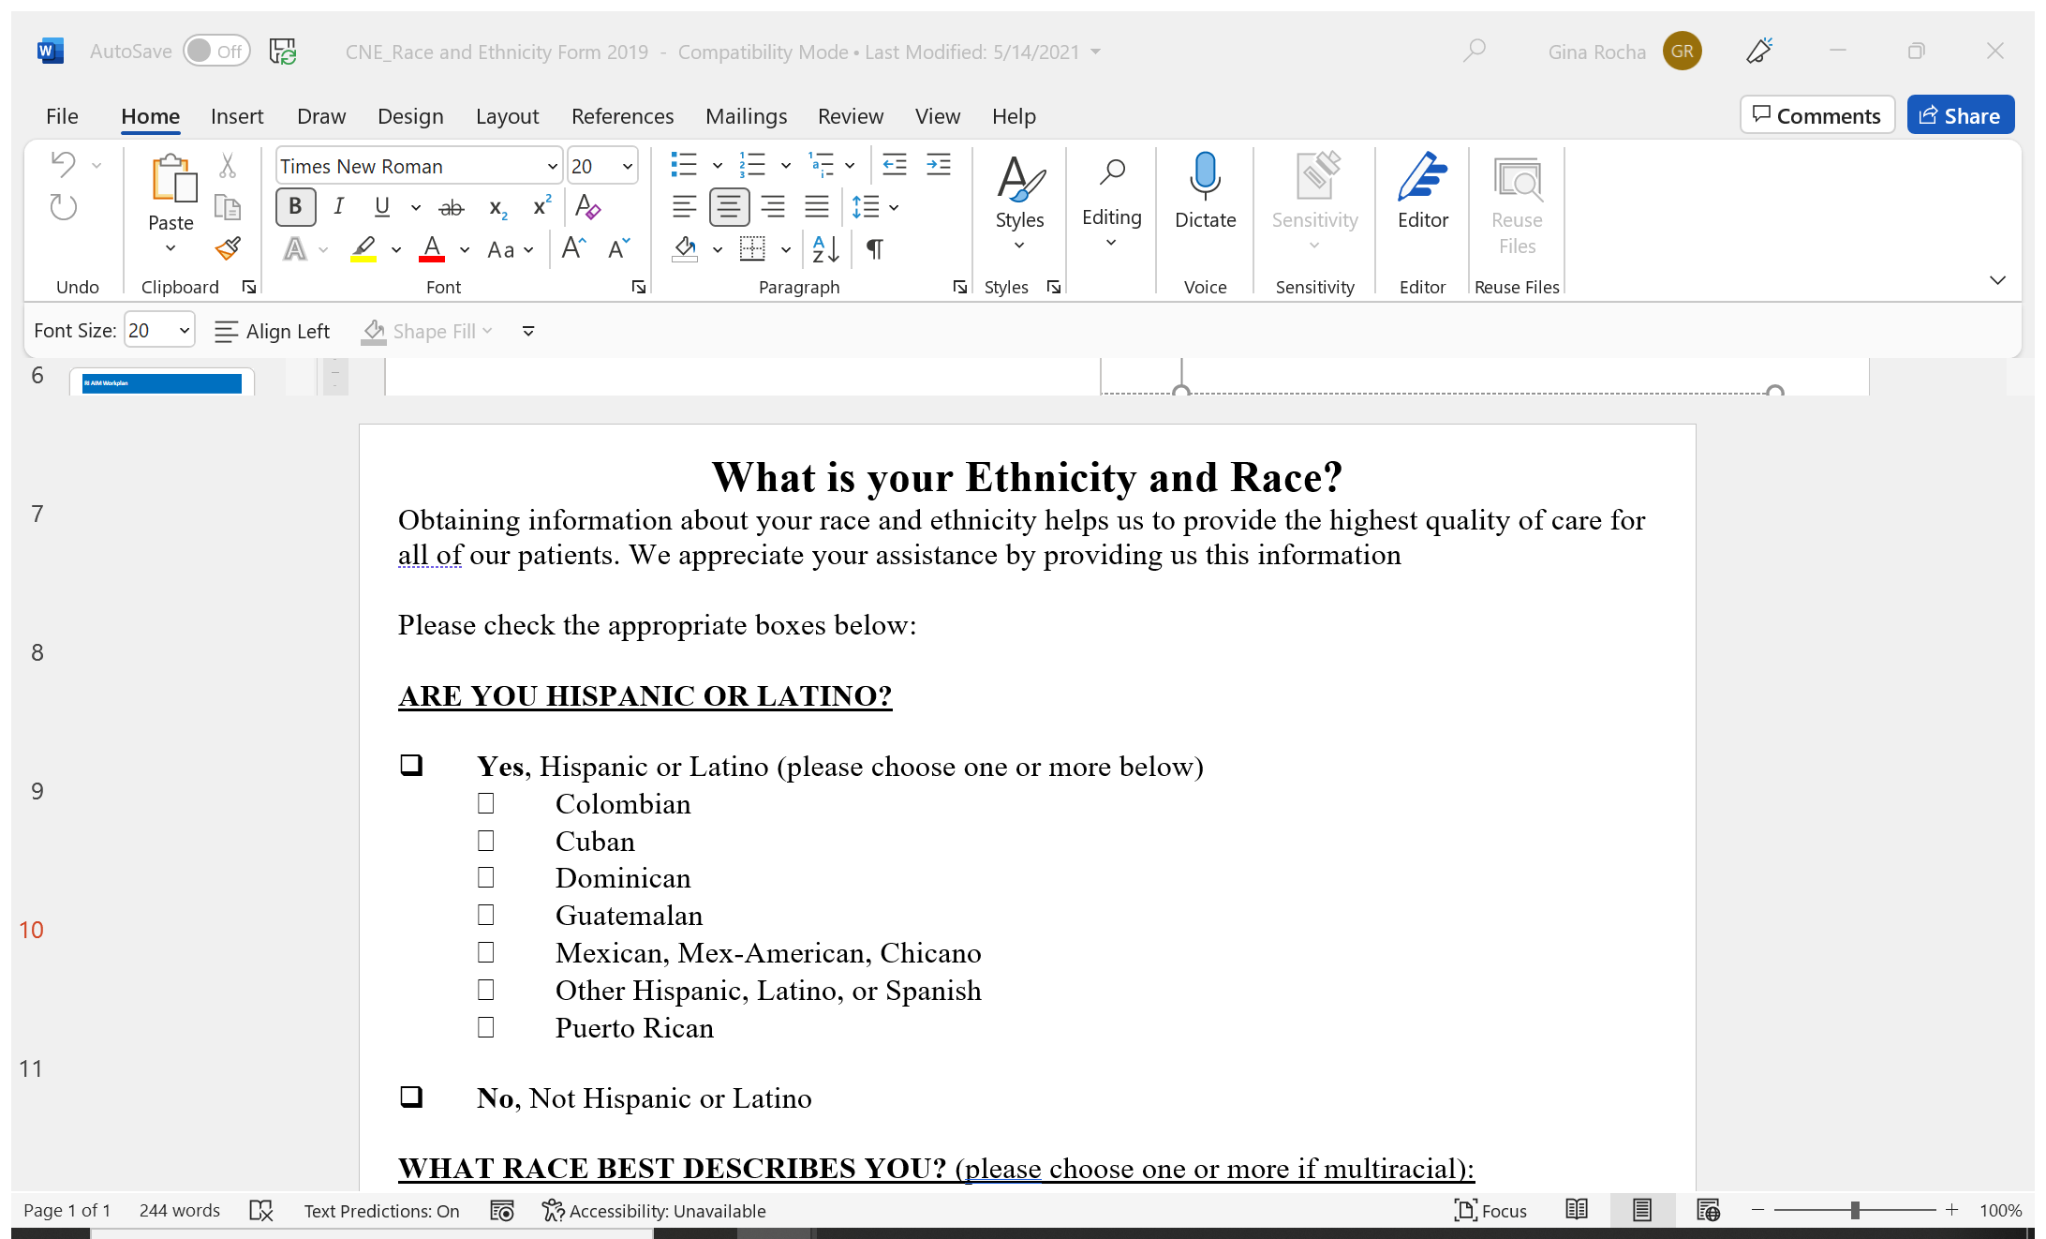
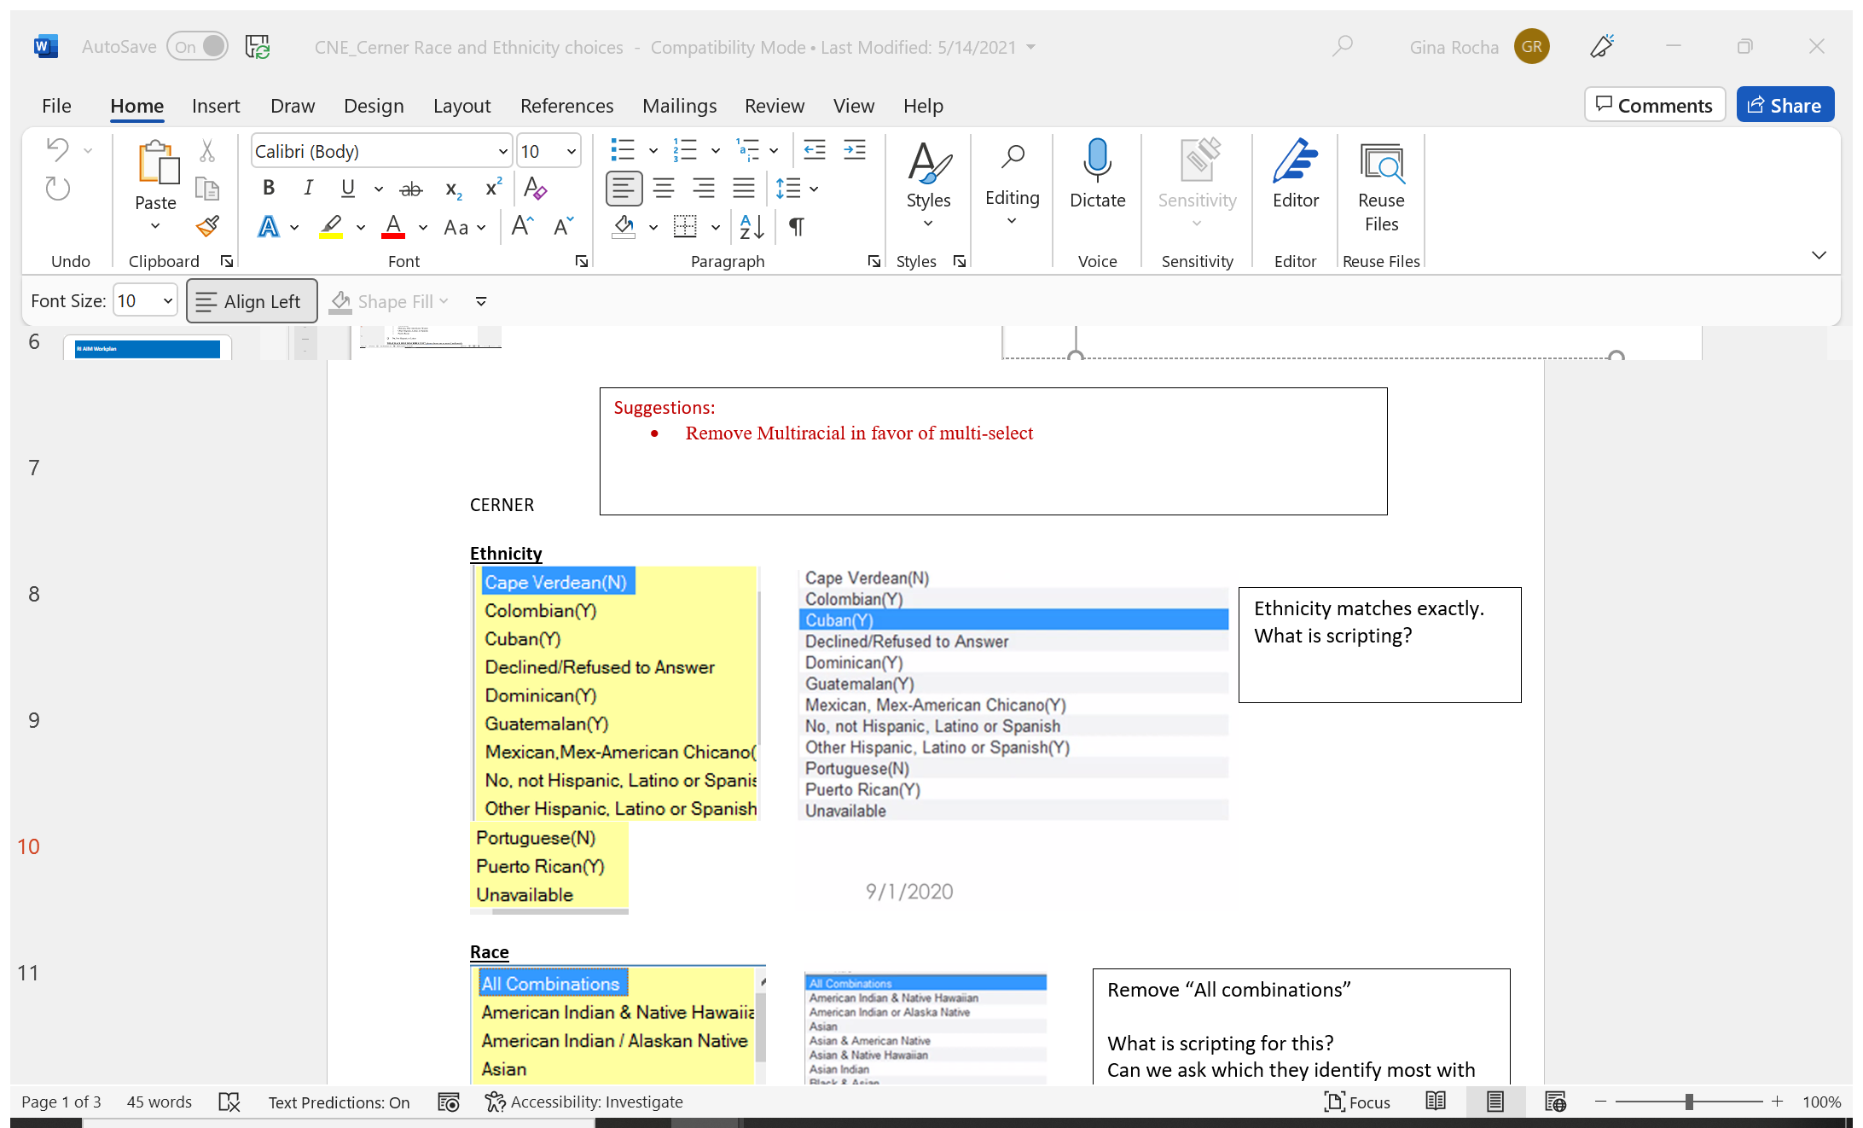
Race and Ethnicity Data Improvement Efforts

Slide 12
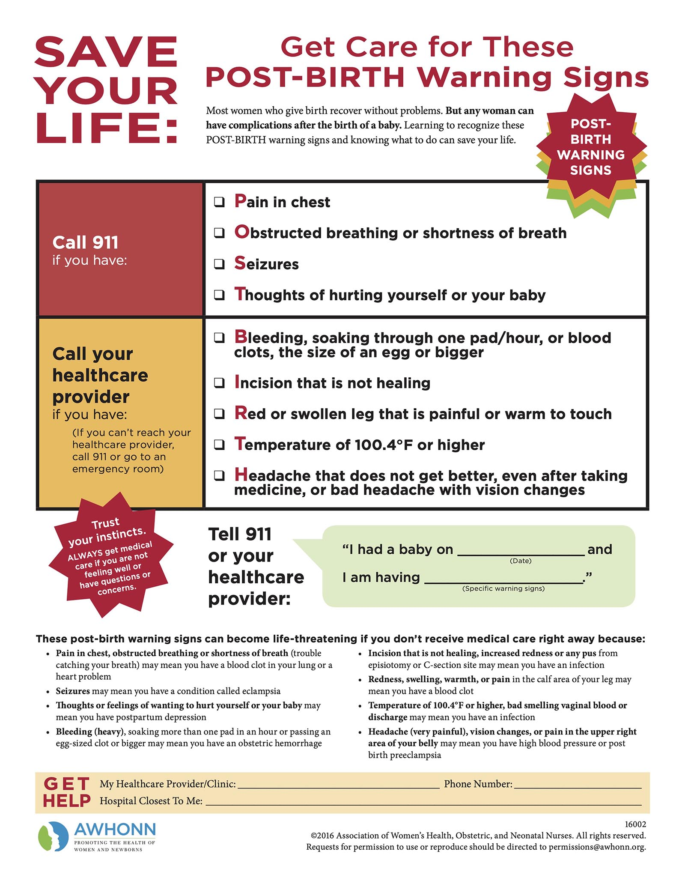
RI Collaborative Training Initiatives :
7565- English Language Magnets
1760- Spanish Language Magnets
170 – PBWS AWOHNN Education Seats

Slide 13
Hospitals in RI: Improvement Journey
Gap analysis performed of the 4 R’s revealed partial compliance and room for optimizing existing processes
Core team created to bring practices into compliance
Organized the work into 4 categories:
Process, Response Tools, Documentation, Reporting/Tracking
Improved oral and written communication
Antepartum /Admission Risk factors (Low, Medium High)
Oxytocin Medication Management

Slide 14
Successes & Challenges :
Successes:
PPDRC issued 2021 Report and Recommendations :
Substance Use Disorder • Emergency Care • Postpartum Care • Family Visiting Services • Stable Housing • Diversity, Equity, & Inclusion • Additional Patient Care Recommendations
PNQCRI official launch May 4, 2022, with an area of most concern mental health- assessment, access to providers
Hospital Discharge Data Vendor Assessment: Race and Ethnicity Delivery Study
Challenges
Staffing shortages; low levels of resilience; high acuity, ongoing Covid 19

Slide 15

Rhode Island
Thank you !

